Slide 1

EN 14181
Quality Assurance QAL 3
Guenter Haberzettl, ABB Analytical & Advanced Solutions, October 2012

Slide 2
EN 14181
The three QALs and AST
QAL 1
Confirms the suitability of an AMS
for the measuring task according to EN 15267-3
and EN ISO 14956
Manufacturer
Declaration
QAL 2
Calibration procedure of an AMS after commissioning
with Standard Reference Methods (SRM)
Determination of variability & comparison with required Uc
Certified
Body
EN ISO 17025
QAL 3
Ongoing quality assurance during operation.
Regular control of Drift and Precision of the AMS
Responsibility of
Plant Owners
AST
Annual Surveillance Test
Yearly check of an AMS
Certified
Body
EN ISO 17025
© ABB
11/08/26 AnalyzeIT Explorer | <number>

Slide 3

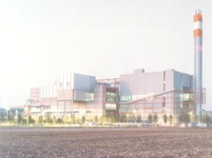


Air Pollution Control
Applications
Comes to application for Continuous Emission Monitoring Systems (CEMS) of :
  Large Combustion Plants Directive (2001/80/EC) (LCPD)
  Systems which have to meet “German - TA Luft“
  Waste Incineration Directive & Co-incineration (2000/76/EC) (WID)
  Industrial Emission Directive (2010/75/EC)
  Ambient-air monitoring (2008/50/EC)
  Impacts Emission Trading CDM & JI Projects (2003/87/EC) Greenhouse Gases
© ABB
11/08/26 CEM / Legislation | <number>

Slide 4
Visit ASN
https://www125.abb.com/sites/ASN/PRU/Products/Advance%20Operation/ProductPages/Software%20Tools.aspx
© ABB
11/08/26 AnalyzeIT Explorer | <number>

Slide 5
EN 14181
QAL1…3 over time, with references
Certification test of AMS
ISO 14956:2002
- Calculation of total uncertainty
EN 14181:2004
- Calibration of AMS with reference measurements (SRM)
- Determination of variability and comparison with required uncertainty
EN 14181:2004
- Check of drift and precision of AMS
EN 14181:2004
- Functional check
Plant staff
QAL 3
Test laboratories
Test laboratories
Test laboratories
Test laboratories
Manufacturerr
QAL 2
QAL 2
QAL 1
AST
AST
~
~
1 Year
1 Year
Time
Installation of AMS on plant
Maximum of 5 years
Less in cases of either changes of plant operation or repair of AMS
or exceeding of valid calibration range of AMS
AST = Annual Surveillance Test
AMS = Automated Measuring System
SRM = Standard Reference Method
© ABB
11/08/26 AnalyzeIT Explorer | <number>

Slide 6
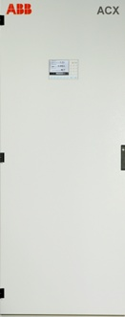
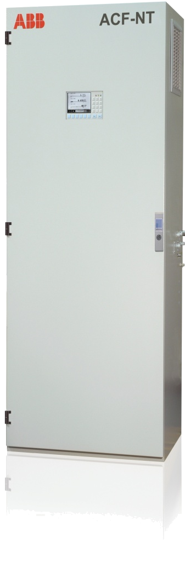

EN 14181
QAL3 Ongoing Quality Monitoring • For Plant Owners
Regular control of Drift and Precision
of the AMS
The plant owner is responsible
for QAL 3 monitoring
Evaluation according CUSUM or Shewhart control charts
Test performed minimum 1 time
the certified maintenance interval
© ABB
11/08/26 AnalyzeIT Explorer | <number>

Slide 7
EN 14181
QAL3 Ongoing Quality Monitoring • For Plant Owners
A full new calibration (QAL2) shall be
performed within 6 months if any of the
following conditions ^{*)} occur :
If > 5% of the number of measured values
between 2 ASTs are outside the valid
calibration range for more than 5 weeks
If > 40% of the number of measured values
are outside the valid calibration range for
more than 1 week
*) According Para. 6.5 of the EN14181
© ABB
11/08/26 AnalyzeIT Explorer | <number>

Slide 8
EN 14181
Compare of CUSUM and Shewhart Control Charts
CUSUM ¹⁾ – Control Chart
Determines separately
Drift and Precision
of the AMS
at the zero and
reference point
Higher Flexibility
1) Cumulative sum chart
Shewhart ²⁾ – Control Chart
Determines the combined
Drift and Precision
of the AMS
at the zero and
reference point
Easier procedure
2) Named after Walter Shewhart
© ABB
11/08/26 AnalyzeIT Explorer | <number>

Slide 9
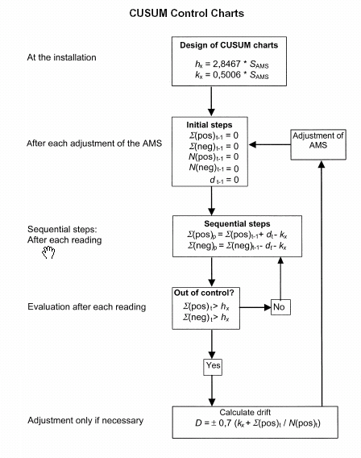
EN 14181
QAL3 Details
Setpoint concentrations
at zero and reference point
Control Chart
Algorithm
Cusum
or
Shewhart
Out-of-control situation for
Drift and Precision of the AMS
Measured concentrations
at zero and reference point
Documentation / Charts
Standard deviation S_{AMS}
© ABB
11/08/26 AnalyzeIT Explorer | <number>

Slide 10
Standard deviation S_{AMS}
© ABB
11/08/26 AnalyzeIT Explorer | <number>

Slide 11

QAL 3 – Demonstrate the required quality of an AMS
Standard deviation S_{AMS}
S_{AMS} value necessary for evaluation according CUSUM or Shewhart charts
Method 1
Using the Uncertainies Uc obtained during the suitability test
Additional performance data of the AMS for each of the influence factors
U_{inst} Is the uncertainty from stability
U_{temp} Is the uncertainty relating from variations in ambient temperature
U_{volt} Is the uncertainty relating from variations in voltage
U_{pre} Is the uncertainty relating from the variation of pressure
U_{others} Is any other uncertainy that may influence the reading on zero and reference material
Calculate
© ABB
11/08/26 AnalyzeIT Explorer | <number>

Slide 12
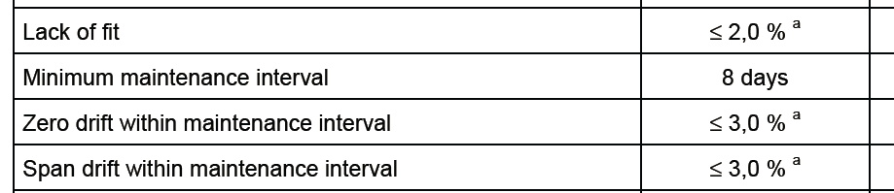
QAL 3 – Demonstrate the required quality of an AMS
Standard deviation S_{AMS}
Method 2
Following the performance criteria of the EN 15267-3
Extract of table 2
© ABB
11/08/26 AnalyzeIT Explorer | <number>

Slide 13
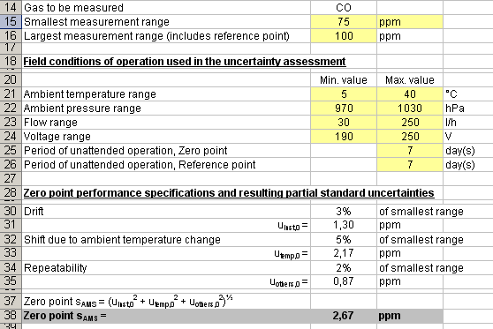
QAL 3 – Demonstrate the required quality of an AMS
Standard deviation S_{AMS}
(75 ppm x 3%)/ √3 = 1,30 ppm
Calculate
© ABB
11/08/26 AnalyzeIT Explorer | <number>

Slide 14
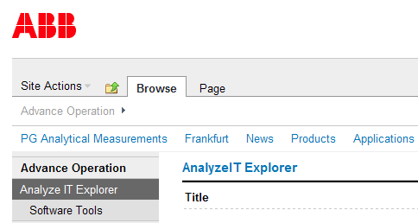
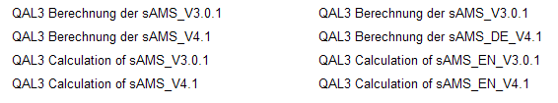
QAL3
How to find on ASN
https://www125.abb.com/sites/ASN/PRU/Products/Advance%20Operation/ProductPages/Software%20Tools.aspx
© ABB
11/08/26 AnalyzeIT Explorer | <number>

Slide 15
QAL 3 – Demonstrate the required quality of an AMS
Standard deviation S_{AMS}
Method 3
Accpeted by different compentent authorities in Europe
Practice according to the technical guidance VDI 3950
3% of the measuring range shall be used for control chart limits
© ABB
11/08/26 AnalyzeIT Explorer | <number>

Slide 16

Shewhart Control Charts
AMS “Inside the Control Range“
The difference dt
between measured values and the set points
must be less or equal
to the result of the calculation 2 x S_{AMS}
AMS “Outside Control Range“
The difference dt
between measured values and the set points
is greater
as the result of the calculation 2 x S_{AMS}
© ABB
11/08/26 AnalyzeIT Explorer | <number>

Slide 17
QAL 3 – Demonstrate the required quality of an AMS
Shewhart Control Chart
Example (Based on Method 3)
ELV NO_{x} = 100 mg/m³ for e.g. a LCP
Measuring range NO_{x} = 250 mg/m³ (100 x 2,5)
S_{AMS} 250 mg/m³ x 3% = 7,5 mg/m³
Shewhart evaluation 2 x S_{AMS} = 2 x 7,5 mg/m³ = ± 15 mg/m³ Threshold limit
© ABB
11/08/26 AnalyzeIT Explorer | <number>

Slide 18
Shewhart Control Chart • QAL3
Example (Based on Method 3)
S_{AMS}
3
Out of range
Out of range
15 mg/m³
2
Alarm (≥ 2 x S_{AMS})
1
0
t
-1
15 mg/m³
-2
Alarm (≥ 2 x S_{AMS})
Out of range
-3
1 2 3 4 5 6 7
Number of tests
© ABB
11/08/26 AnalyzeIT Explorer | <number>

Slide 19
Example for Shewhart Control Chart • QAL3
Normal behavoir of an AMS
S_{AMS}
3
2
Out of control
2 x S_{AMS}
1
0
t
t1
t2
t3
t4
t5
Maintenance interval
-1
-2
2 x S_{AMS}
Out of control
-3
© ABB
11/08/26 AnalyzeIT Explorer | <number>

Slide 20
Example for Shewhart Control Chart • QAL3
AMS shows drift, but is still in the allowed range
S_{AMS}
3
2
Out ofcontrol
2 x S_{AMS}
1
0
t
t1
t2
t3
t4
t5
Maintenance interval
-1
-2
2 x S_{AMS}
Out of control
-3
© ABB
11/08/26 AnalyzeIT Explorer | <number>

Slide 21
Example for Shewhart Control Chart • QAL3
AMS is out of control
S_{AMS}
Alarm
3
2
Out of control
2 x S_{AMS}
1
0
t
t1
t2
t3
t4
t5
Maintenance interval
-1
-2
2 x S_{AMS}
Out of control
-3
© ABB
11/08/26 AnalyzeIT Explorer | <number>

Slide 22
QAL3 • Check of Precison of the AMS
Example by using CUSUM - Charts
Main measurands and values are required to know
  k_{s} Threshold limit k_{s} = 1,85 * S²_{AMS}
  h_{s} Test value h_{s} = 6,90 * S²_{AMS}
  s_{p} Provisional normalised sum of of standard deviation of the AMS
  s_{t} Provisional normalised sum of of standard deviation of the AMS at time t
  s_{t-1} Provisional normalised sum of of standard deviation of the AMS at time t-1
  d_{t} Difference between actual value of the AMS and the reference value
© ABB
11/08/26 AnalyzeIT Explorer | <number>

Slide 23


QAL3 • Check of Drift of the AMS
Example by using CUSUM - Charts
Main measurands and values are required to know
  k_{x} Threshold limit k_{x} = 0,501 * S_{AMS}
  h_{x} Test value h_{x} = 2,85 * S_{AMS}
Previous normalised sum of positive drift of the AMS
Previous normalised sum of negative drift of the AMS
© ABB
11/08/26 AnalyzeIT Explorer | <number>

Slide 24
Ongoing Quality Assurance • QAL3
Check of Drift of an AMS using CUSUM Charts
Drift
Alarm
3
Out of range
h_{x} = 2,85 x S_{AMS}
2
K_{x} = 0,501 x S_{AMS}
1
∆
∆
0
∆
t
t1
t2
t3
Maintenance interval
-1
-2
-3
Out of range
h_{x} = Test value for the dedection of drift
k_{x} = Constant for the calculation of the interim amount
© ABB
11/08/26 AnalyzeIT Explorer | <number>

Slide 25
Ongoing Quality Assurance • QAL3
Check of Precision of an AMS using CUSUM Charts
Maintenance required
30
20
h_{s} = 6,90 x S²_{AMS}
10
s_{t}
0
t
-10
t1
t2
t3
t4
t5
t6
t7
Maintenance interval
-20
-30
h_{s} = Test value for the detection of a decrease in the precision.
s_{t} = Interim standardized amount of the standard deviations of the AMS at the point of time t
s_{t} ≤ h_{s} → AMS is operating in control range
st ≥ hs → AMS is operating out control range
© ABB
11/08/26 AnalyzeIT Explorer | <number>

Slide 26
Analyze^{IT} Explorer - Integrated Functions
© ABB
11/08/26 AnalyzeIT Explorer | <number>

Slide 27
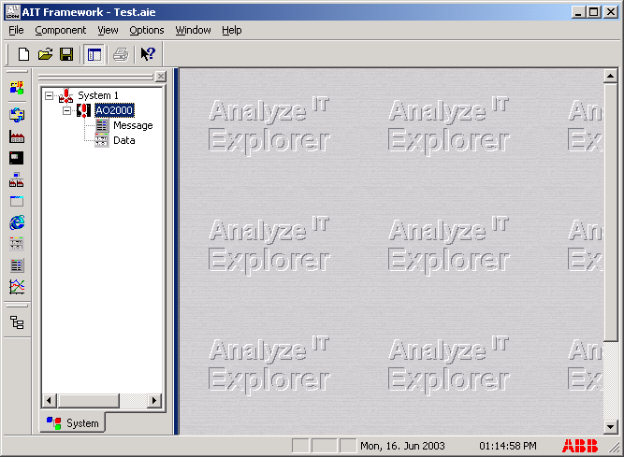
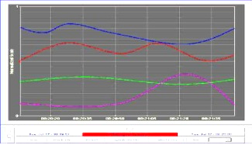
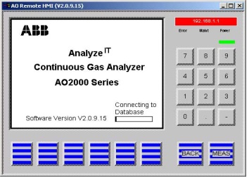
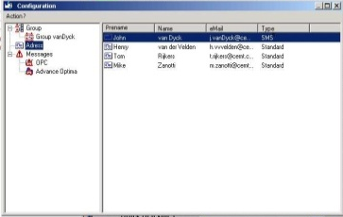
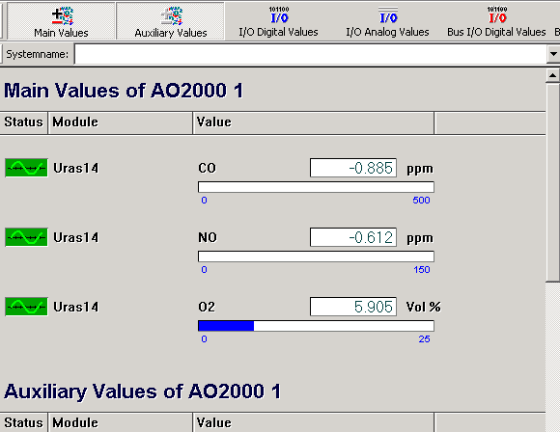
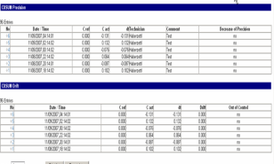
Analyze^{IT} Explorer
Integrated Functions
Visualize measuring values
Displays status messages in a
conspicuous place
Allow complete remote operation
Graphic and trend chart recorder
Maintain audit logs
E-mail or SMS messaging possible
Continuously records selected data
QAL3 evaluation acc. EN 14181
Networking
© ABB
11/08/26 AnalyzeIT Explorer | <number>

Slide 28
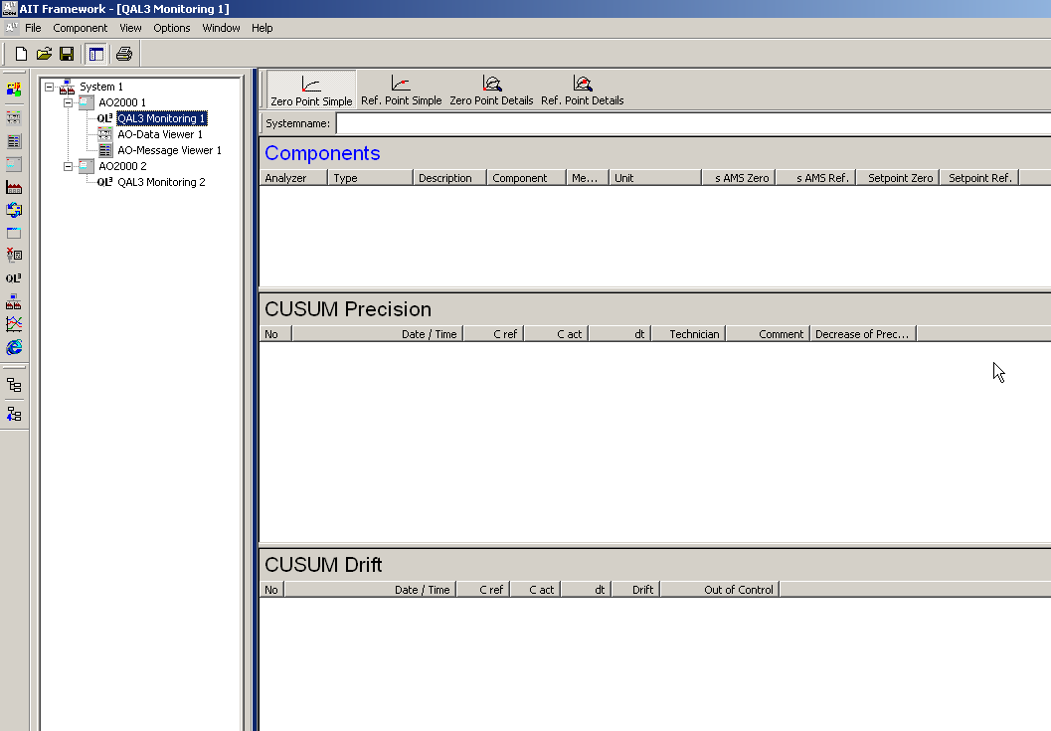
QAL3 Monitoring
© ABB
11/08/26 AnalyzeIT Explorer | <number>

Slide 29
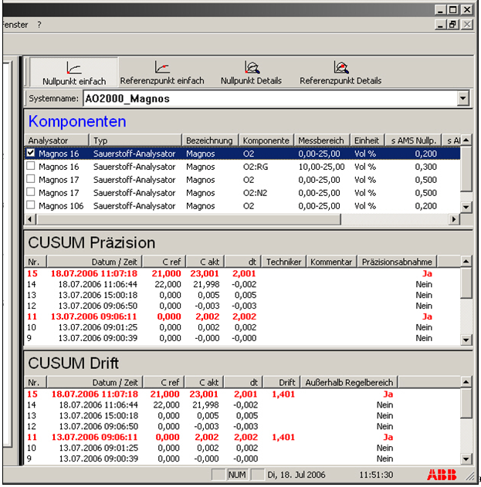
QAL3 Monitoring
© ABB
11/08/26 AnalyzeIT Explorer | <number>

Slide 30
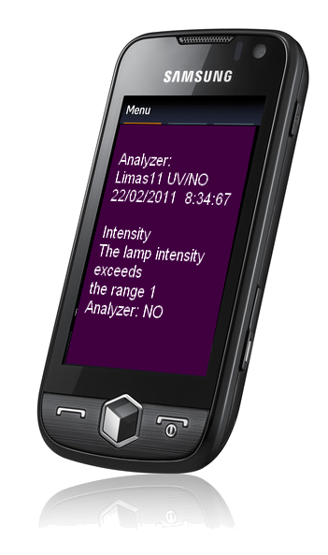
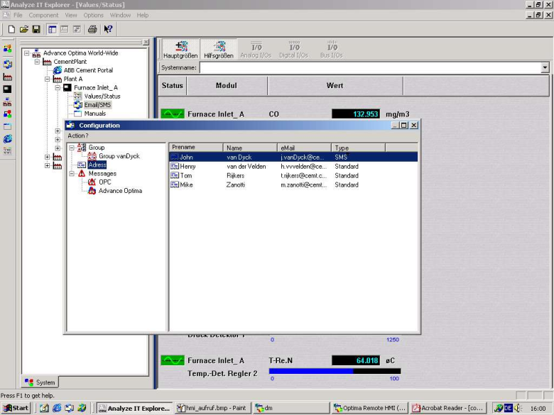
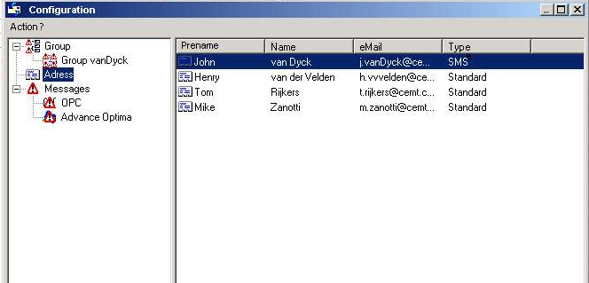
Status and Messages
Email /SMS Text Messaging
© ABB
11/08/26 AnalyzeIT Explorer | <number>
Notes:
Messaging component can be enabled to send out email messages and SMS (short message system) to cell phones.

